Slide 1

[Samsung PRISM] Monthly Connect
AI/ML: Age,Gender and emotion detection from speech
Team
College Professor(s):
1) Dr J Selvin Paul Peter, Associate Professor, Department of Computing Technologies, selvinpj@srmist.edu.in
2)Dr P Murali, Associate Professor, Department of Computing Technologies, muralip@srmist.edu.in
Students:
Rishabh Agrawal / ra7546@srmist
Raghav Khanna / ri9320@srmist.edu.in
Aaryaman bajaj / an1143@srmist.edu.in
Nilanjana Bhattacharya / nb2168@srmist.edu.in
Department: Cse Core (Computing Technologies)

Slide 2
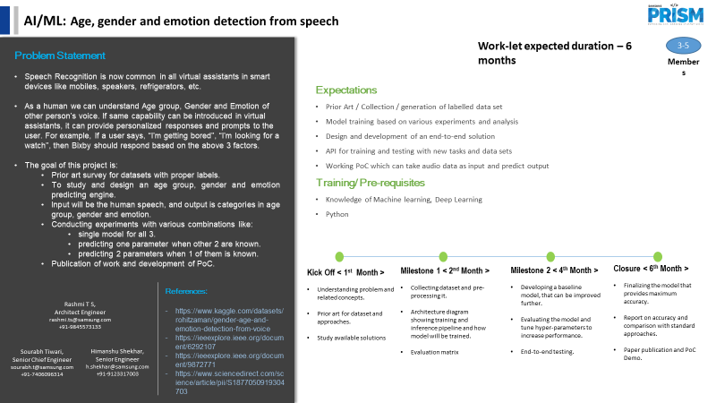

Slide 3
Work-let Name :- AI/ML: Age, Gender and emotion detection from speech
Worklet Details
Worklet ID: 23VI26SRM
College Name: SRMIST
KPIs Achieved Till Now
Data Preprocessing Accuracy:
Measure the accuracy of your data preprocessing steps in terms of cleaning, feature extraction, and data preparation. Ensure that the data is properly formatted and ready for model training.
Data Quality Metrics:
Assess the quality of your dataset by calculating statistics like data completeness, missing values, and outliers before and after preprocessing
Labeling Accuracy:
If you manually labeled your data, measure the accuracy of the labeling process to ensure that age, gender, and emotion labels are correctly assigned to the speech samples.
Date: 26/09/2023

Slide 4
Work-let Name :- AI/ML: Age, Gender and emotion detection from speech
Data Exploration
Preprocessing Efficiency
Data Pipeline Robustness
Use of Recent Literature
Collaboration and Feedback

Slide 5
Any Challenges/ Issues faced
Work-let Name :- AI/ML: Age, Gender and emotion detection from speech
Rapidly Evolving Field:
Speech analysis, particularly in deep learning, is rapidly evolving.
New techniques, models, and datasets are frequently emerging.
Keeping up with the latest advancements can be challenging.
Variability in Approaches:
Researchers employ diverse methodologies, features, and models.
Comparing and evaluating techniques becomes complex due to variability.
Understanding the pros and cons of different approaches is essential
Lack of Standardized Datasets:
Limited availability of standardized, well-annotated datasets.
Combining various datasets may introduce data heterogeneity
- Addressing data quality issues becomes important for reliable results.

Slide 6
Work-let Name :- AI/ML: Age, Gender and emotion detection from speech
Bias and Fairness:
Research on bias and fairness is crucial in gender, age, and emotion detection.
Identifying potential biases in data, features, and models is vital.
Ensuring ethical considerations and minimizing bias is a key project goal.
Cross-Cultural and Linguistic Differences:
Challenges related to cross-cultural and linguistic variations exist.
The literature may not extensively cover these challenges.
Seeking studies that explicitly address these variations is necessary.
Ethical and Privacy Concerns:
Speech analysis involving sensitive attributes raises ethical and privacy concerns.
Understanding how these concerns are handled in existing research is essential.
- Ensuring data protection and user consent are integral to project design.

Slide 7
Next Steps
Work-let Name :- AI/ML: Age, Gender and emotion detection from speech
1.Baseline Model:
- Create simple baseline for age, gender, emotion prediction.
- Initial reference for assessing complex models.
2.Model Selection and Development:
- Pick ML/DL methods for each task.
- Start with one task, evolve iteratively.
3. Hyperparameter Tuning:
- Optimize using grid/random search, Bayesian methods.
- Choose best parameters from validation set.
4.Model Evaluation:
- Measure using accuracy, precision, recall, F1-score.
- Cross-validation for robust estimates.

Slide 8
Outcome till now
Work-let Name :- AI/ML: Age, Gender and emotion detection from speech
Datasets studied:
CREMA-D DATASET
EMO-DB DATASET
COMMON VOICE DATASET
IEMOCAP DATASET

Slide 9
Work-let Name :- AI/ML: Age, Gender and emotion detection from speech
1. Features for Age:
-Sentiment Scores, Pitch, Speaking Rates, Transcripts
-Energy, Formant, F0 values, MFCCs, Chroma, Spectral Contrast
2. Features for Gender:
- Pitch, formant, MFCC, energy,F0 Values
3. Features for Emotion:
- Frequency, Amplitude , Chroma
-MFCC, Spectral contrast, Sentiment Score

Slide 10
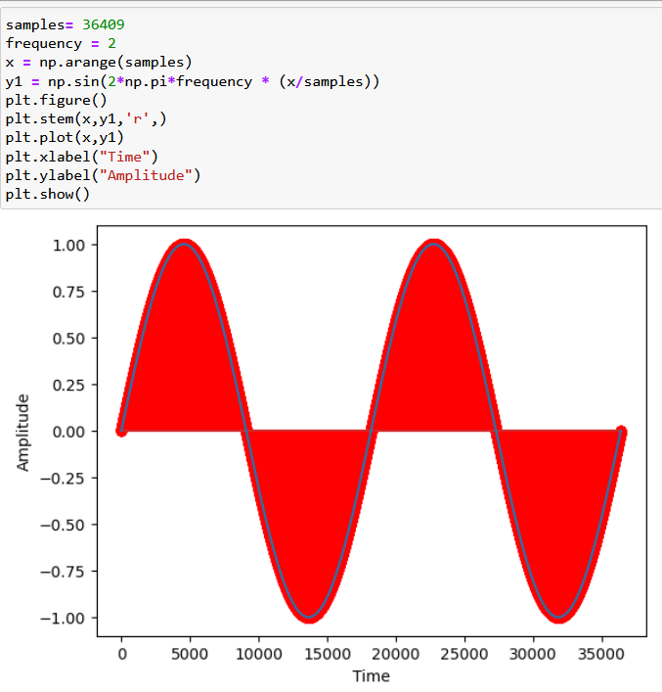
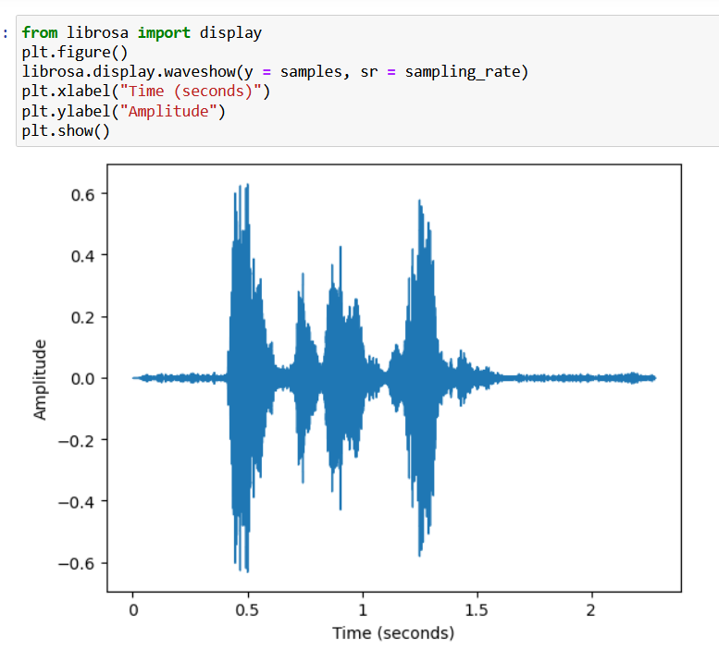
Work-let Name :- AI/ML: Age, Gender and emotion detection from speech
EMOTION
.

Slide 11
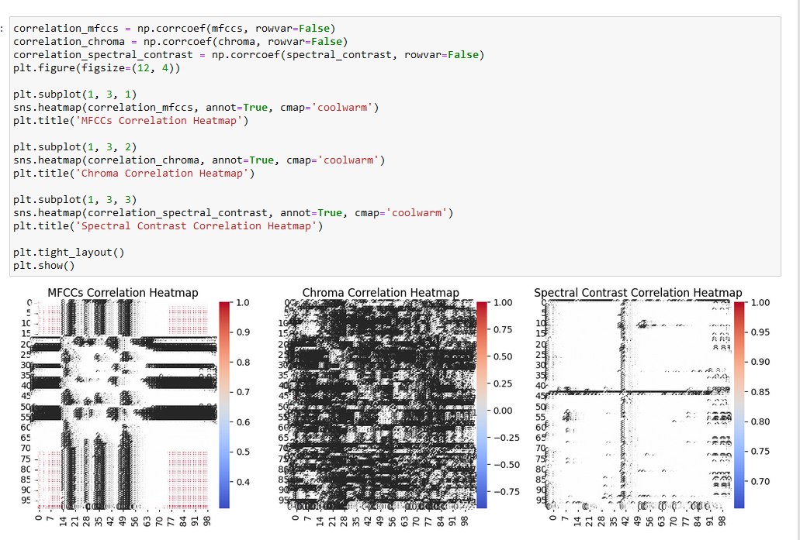
Work-let Name :- AI/ML: Age, Gender and emotion detection from speech

Slide 12
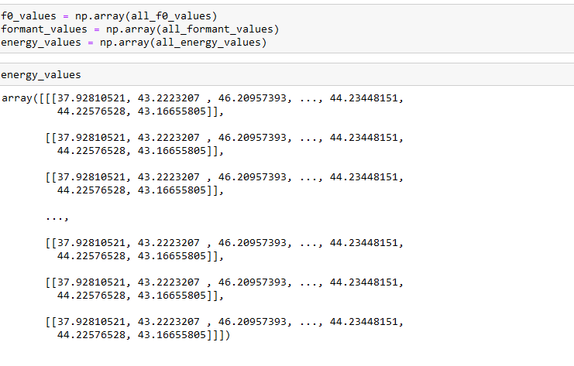
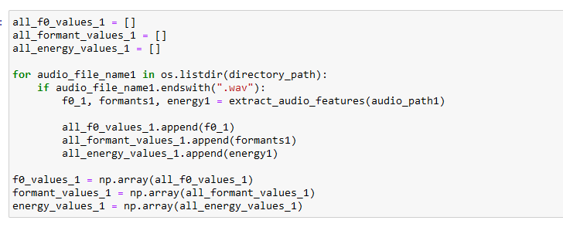
Work-let Name :- AI/ML: Age, Gender and emotion detection from speech
GENDER

Slide 13
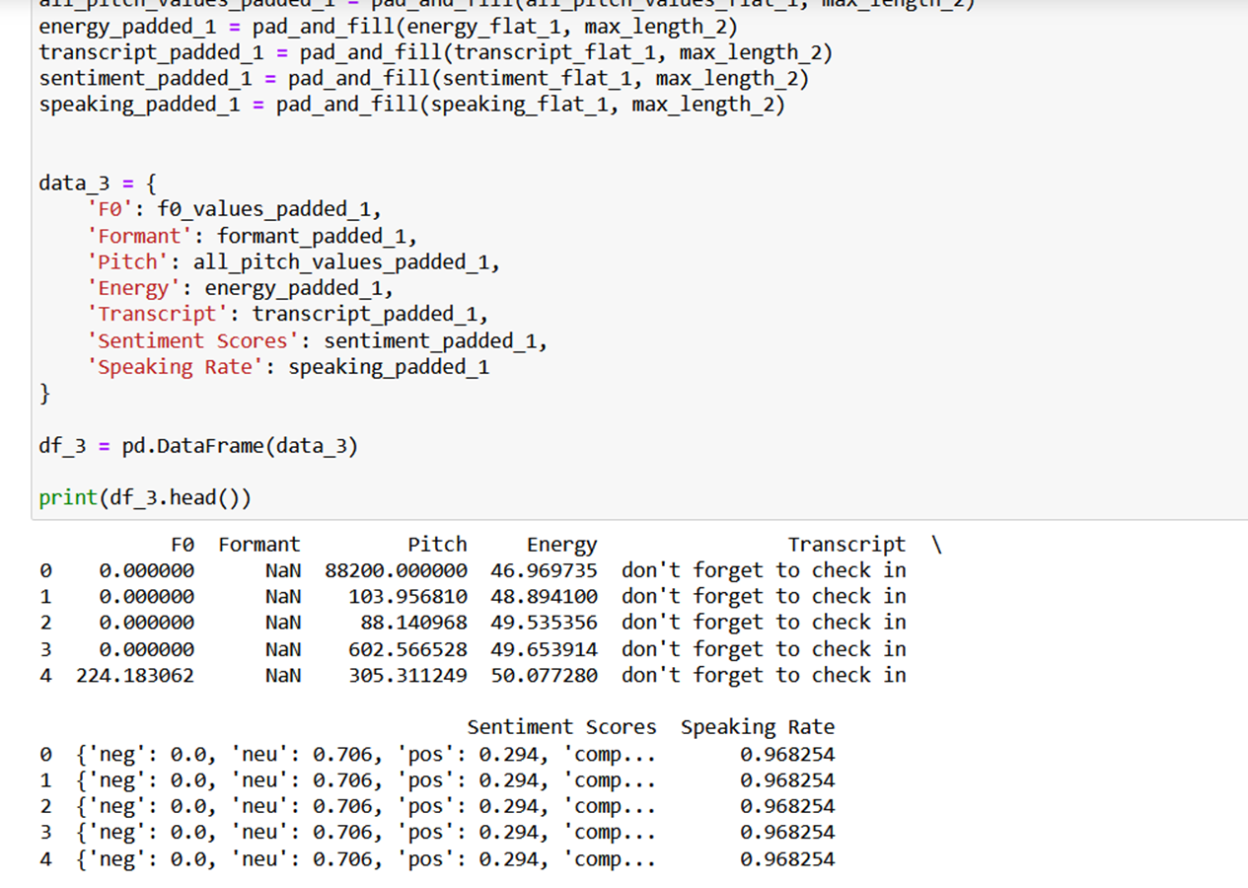
Work-let Name :- AI/ML: Age, Gender and emotion detection from speech
AGE

Slide 14
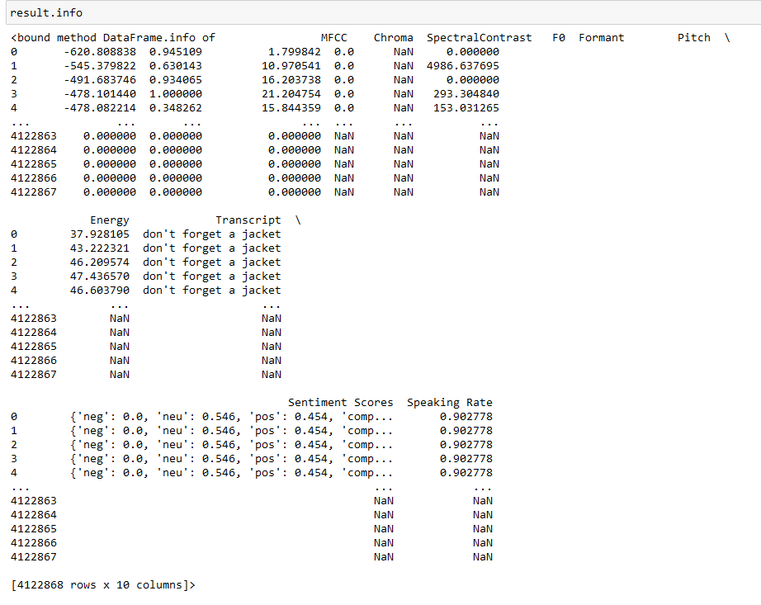
Work-let Name :- AI/ML: Age, Gender and emotion detection from speech

Slide 15
Work-let Name :- AI/ML: Age, Gender and emotion detection from speech
Thank you
Thank you

